Slide 1
Partial Citizenship in the Era of Exclusion
Keynote speech, Symposium on Partial Citizenship of Family Migrants, 2016/Oct/1, Rikkyo University
ILCAA Joint research project “Child mgiration in asia”
Rhacel Salazar Parreñas
Professor of Sociology and Gender Studies
University of Southern California

Slide 2
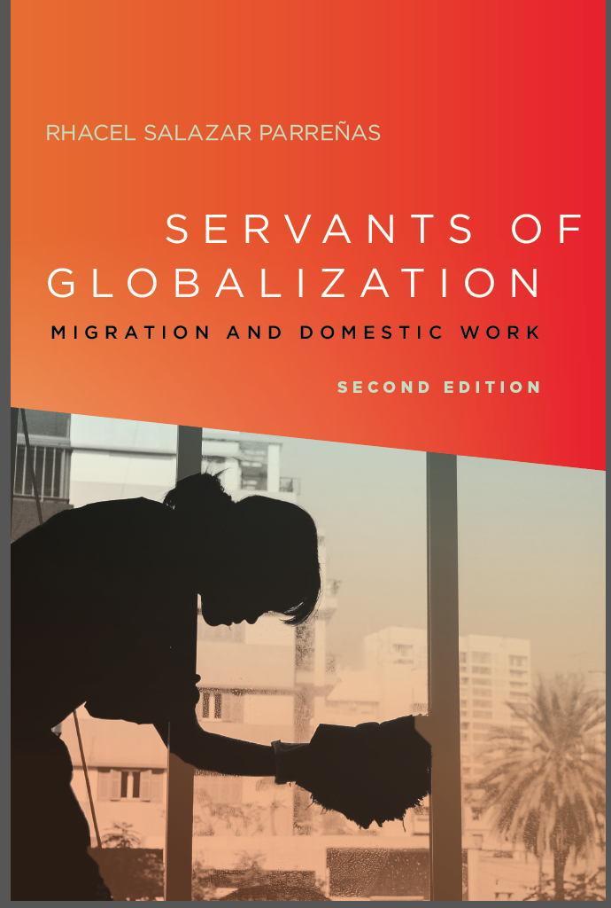

Slide 3
Goals of Lecture
2
Revisit and unpack definition of partial citizenship
Underscore two principles that underlie partial citizenship:
Politics of exclusion
Status of migrants as unfree workers
Examine applicability of concept to other groups of migrants

Slide 4
Domestic Workers - Excluded and Unfree
3
Most destinations still exclude domestic workers from labor law protection (examples: Gulf Cooperative Council nations, Taiwan, Singapore, Israel).
Most destinations render domestic workers “unfree” as their residency is conditional to their employment by a sponsor and they have limited flexibility to change sponsors
Most destinations exclude domestic workers from eligibility for permanent residency
Most destinations limit the reproductive rights of domestic workers

Slide 5
Partial citizenship or deterritorialized citizenship?
4
Expanding efforts by sending states to protect migrant workers
Examples are government branch offices that service migrant workers across the Philippine diaspora

Slide 6
Applicability of partial citizenship
5
Other temporary migrant workers – entertainers
Undocumented workers
Marriage migrants

Slide 7
Foregrounding exclusion
6
Partial citizenship
Postnational citizenship
Flexible citizenship

Slide 8
Conclusion
7
Partial citizenship foregrounded the shift from
migrant inclusion to migrant exclusion and
the rise of unfree labor

